Slide 1
SAP EWM EXTENDED WAREHOUSE MANAGEMENT TRAINING
AnubhavTrainings.com
www.anubhavtrainings.com

Slide 2

SAP EWM TRAINING
BY:-
Mr. Bijoy
www.anubhavtrainings.com
Notes:
https://unsplash.com/photos/uXB-7la5vqA

Slide 3
Cross Docking
Concept and understanding of Cross docking
Opportunistic Cross-Docking, Define Product group types, Define Product groups
Stock determination group, Maintain Stock determination
Testing execution of Opportunistic Cross-Docking process

Slide 4
EWM Cross Docking
Contents
Cross-docking is a process, which uses the processing of goods in a warehouse by using incoming stock directly for outbound processing without storing in warehouse.
EWM triggered opportunistic cross-docking is a process that works entirely within a single EWM instance and does not need support from other applications or systems. During creation of warehouse tasks for put away or picking, stock determines from docking areas (staging).
NOTE: It is mandatory to activate the BADI’s to use this functionality.

Slide 5
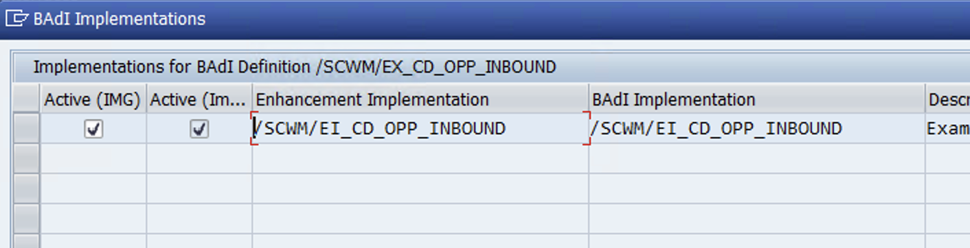
Configuration
BADI: Activation and Adjust Inbound-Triggered Cross docking Process
Spro—SCM EWM—EWM—BADI for EWM—Cross process settings—Cross-docking—Opportunistic Cross docking—EWM-Triggered Cross Docking Inbound—Badi: Activation and Adjustment Inbound-Triggered Cross Docking Process

Slide 6
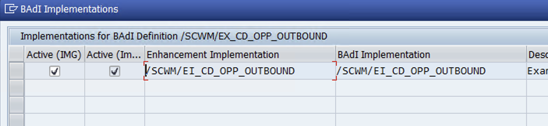
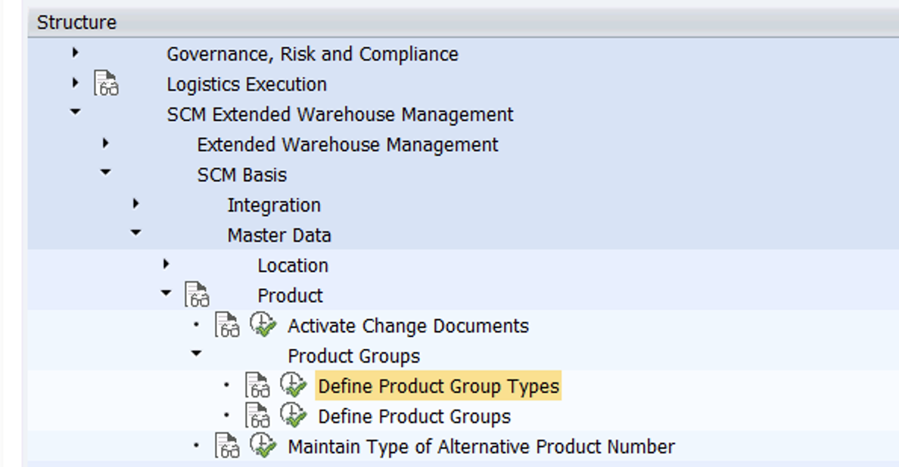
BADI: Activation and Adjust Outbound-Triggered Cross docking Process
NOTE: Product group types and product groups serve to group products of the same kind. You define a product group type for the criterion with which the product groups are to be formed.

Slide 7
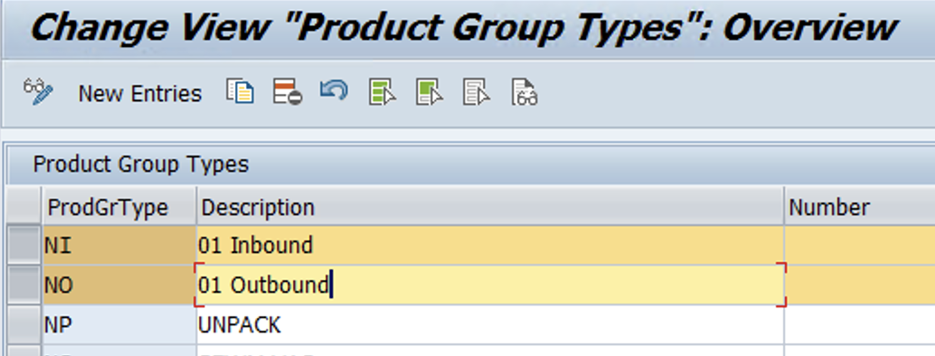
Define Product Group Types

Slide 8
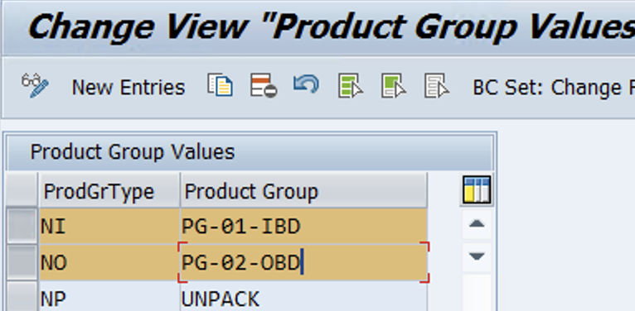
Define Product Group
www.anubhavtrainings.com

Slide 9
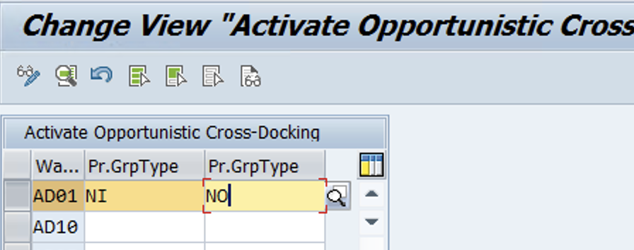
Activate EWM-Triggered opportunistic Cross-Docking
Spro—Img—SCM EWM—EWM—Cross-process settings—Cross-Docking—Opportunistic Cross-docking—EWM triggered opportunistic Cross-Docking—Activate EWM-triggered opportunistic Cross-Docking
www.anubhavtrainings.com

Slide 10
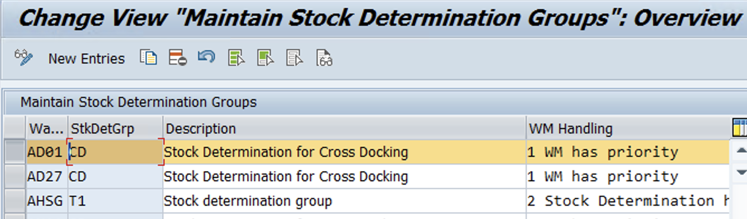
Maintain Stock Determination groups
Spro—Img—SCM EWM—EWM—Cross-process settings—Stock Determination—Maintain Stock Determination groups

Slide 11
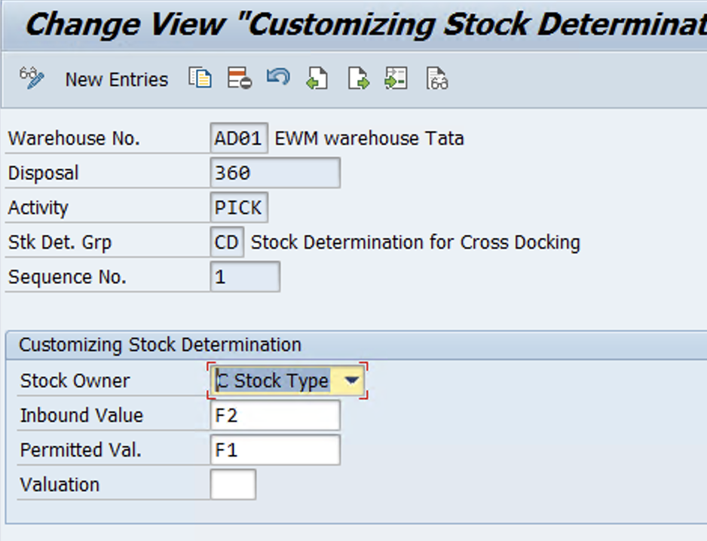
Configure Stock Determination
Same Path as above step)
We need to maintain it because during warehouse task creation with requested stock attributes, the system includes the stocks that possess the permitted attributes in the stock determination.

Slide 12
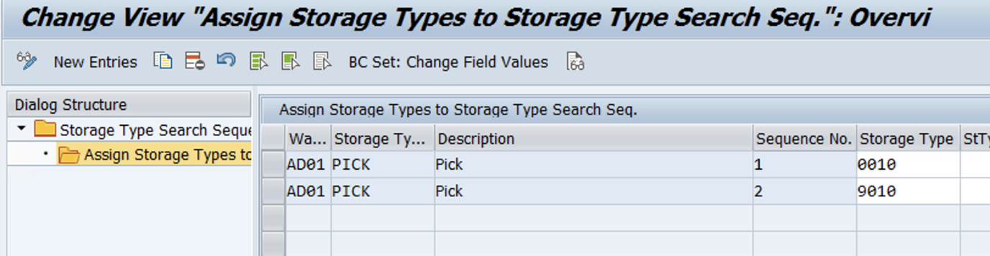
Specify Storage Type Search Sequence
Assign GR staging area in search seq

Slide 13
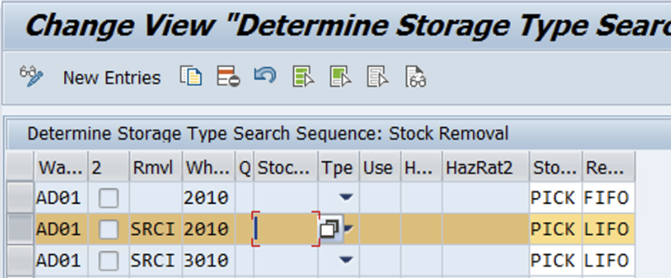
Determine Storage type Search seq
www.anubhavtrainings.com

Slide 14
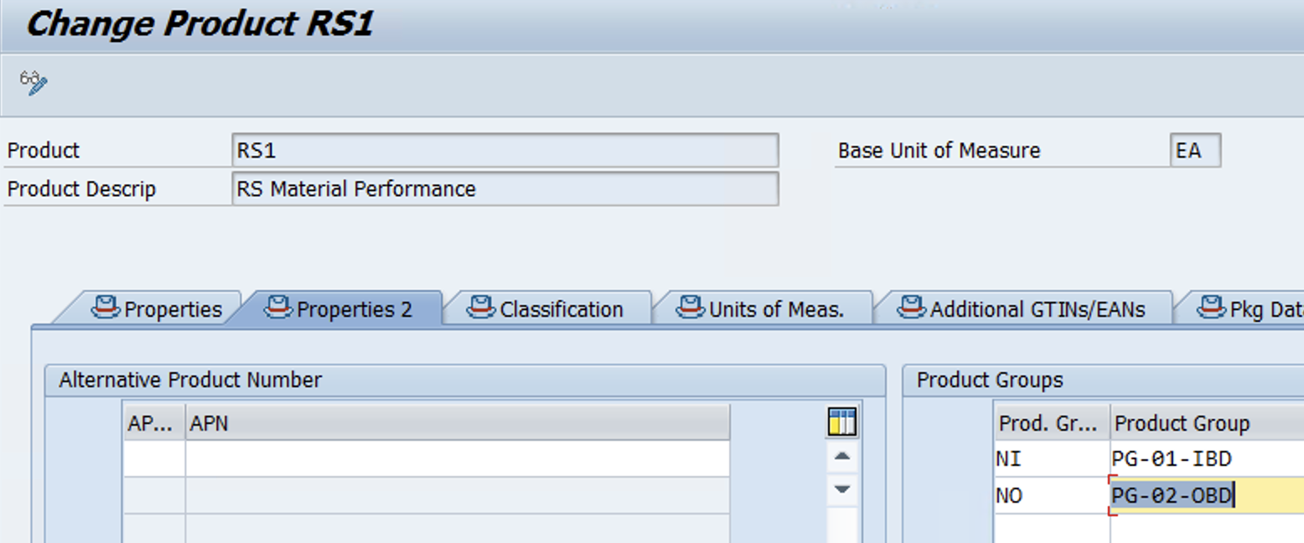
Maintain Product group type and product group:
TRANSACTION: /N/SAPAPO/MAT1
Maintain stock determination group for product under stock removal control area at warehouse level.
TRANSACTION:/N/SCWM/MAT1
www.anubhavtrainings.com

Slide 15
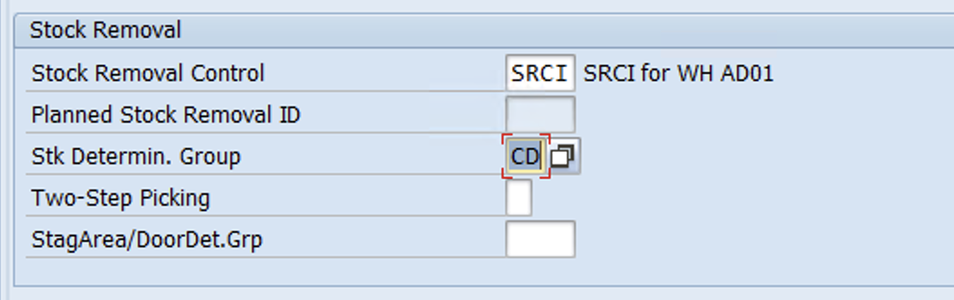
TRANSACTION:/N/SCWM/MAT1
www.Anubhavtrainings.Com

Slide 16
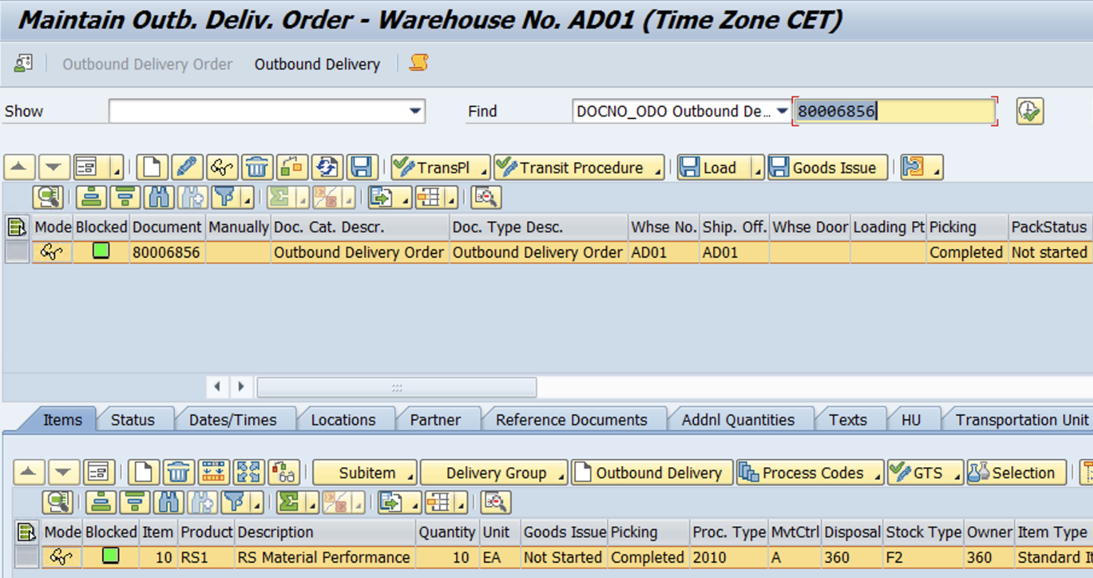
Test Case (Outbound Case)
Before running test case for cross docking, keep ready IBD with GR posted and Check Monitor for 9010 stock
1. Create OBD
www.anubhavtrainings.com

Slide 17
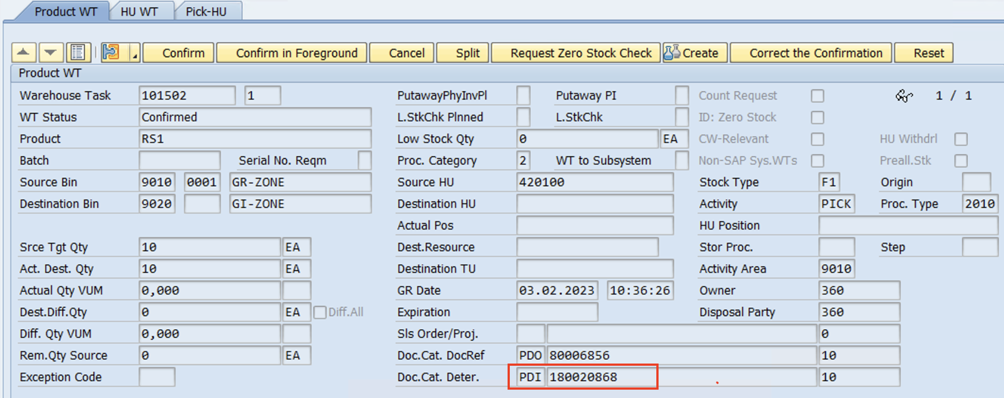
2.Create WT
1. Item has been cross docked - System has picked up the stock from GR staging area! Hence IBD is updated for WT.
www.anubhavtrainings.com

Slide 18
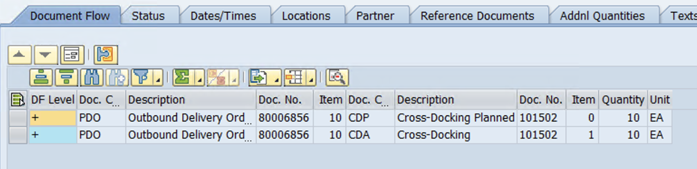
Check OBD document flow (line item details)
www.anubhavtrainings.com

Slide 19
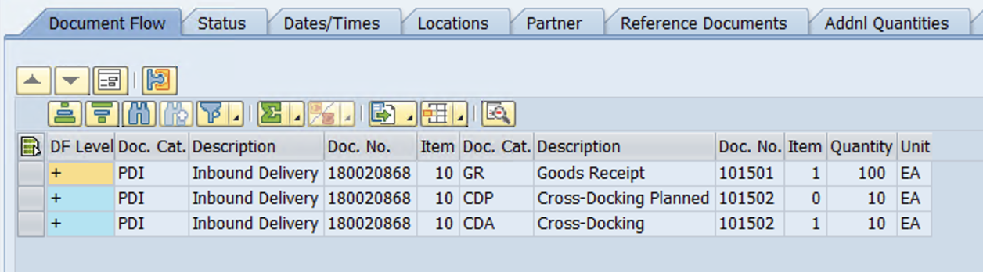
3.Check IBD doc flow
www.anubhavtrainings.com

Slide 20


End of Session
www.anubhavtrainings.com

Slide 21

FEEL FREE TO ASK QUESTIONS

Slide 22

Feedback

Slide 23
THANK
YOU

Slide 24




More from AnubhavTrainings.com

Slide 25






We’re committed to empower you to be
#FutureReady
through powerful training solutions.
We build the workforce of the future.
250+
Corporate Clients
30,000+
Learners Trained
25000+
Learners Placed
FREE WEBINARS
Sign up for free webinars with industry experts every fortnight!
Enroll Now!

Slide 26
FREE WEBINARS
Sign up for free webinars with industry experts every fortnight!
Contact us today!
www.anubhavtrainings.com

